Slide 1
SCRAPING INDEED JOB POSTINGS
Chanchal Duseja
021519003
BTech Data Science (Sem-8)

Slide 2
What is web scraping?
Web scraping, web harvesting, or web data extraction is data scraping used for extracting data from websites.
Web scraping software may directly access the World Wide Web using the Hypertext Transfer Protocol or a web browser.
Web Scraping of job portals is the process of extracting or retrieving jobs related data from internet jobs publishing websites and transforming the collected unstructured data into structured and usable formats.

Slide 3
several ways of web scraping
API: (Application Programming Interface) APIs can be used to access web-based data and services, such as webpages, images, and other content.
HTML Parsers: HTML parsers are programs that parse HTML documents and extract the data from them.
Scrapy: Scrapy is a Python-based web scraping framework that provides a complete toolkit for scraping websites.
Selenium: Selenium is an open-source tool for automating web browsers. It can be used to simulate user actions on a web page and extract data from it.
Wget/Curl: Wget and Curl are command-line programs used to download webpages and other web-based resources. They can be used to access and scrape webpages.

Slide 4
OBJECTIVE
Scraping job postings from Indeed can provide valuable data for various purposes, such as job market analysis, talent acquisition, and career research.
However, the process of scraping job postings from Indeed poses certain difficulties and requires careful consideration to ensure the legality, efficiency, and reliability of the scraping operation.
Unlike the boring and dull process, mind-numbing process of manually extracting data, web scraping uses intelligent automation to retrieve hundreds, millions, or even billions of data points from the internet’s seemingly endless frontier.

Slide 5
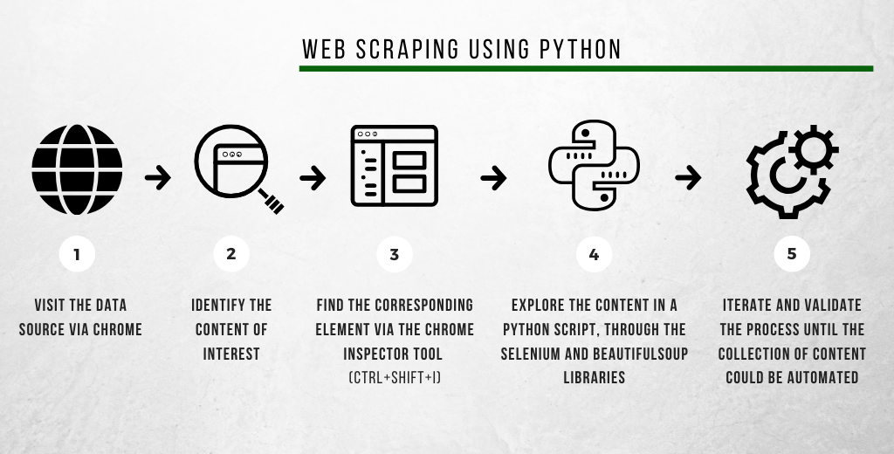
WEB SCRAPING PROCESS USING THE PYTHON LANGUAGE:

Slide 6
ALGorithm of scraping indeed job posting
Start
Enter the search query on the Indeed website
Send a request to the Indeed server
Receive the HTML response from the server
Parse the HTML response using a web scraping library like Selenium or Scrapy
Extract the relevant job posting details such as job title, location, company name, job description, etc.
Save the extracted data in a structured format like CSV, JSON, or a database
Check if there are more pages of job postings
If yes, repeat steps 3-8 for each page until all the job postings have been extracted
End

Slide 7
Tools used
Programming language: Python
Jupyter notebook
In the study we are using selenium, to capture the HTML content and then convert it to a object to parse through it easily and extract the data points.
Selenium Python bindings provides a simple API to write functional/acceptance tests using Selenium WebDriver. Through Selenium Python API you can access all functionalities of Selenium WebDriver in an intuitive way.
Selenium requires a driver to interface with the chosen browser.

Slide 8
Implementation of this project
Step 1: importing all libraries
Step 2: using web driver navigate the page
Step 3: start the search by adding position and location
Step 4: find the job card and find all the details by their HTML tags
Step 5: put it in a dataframe
Step 6: save the datafame into CSV file

Slide 9
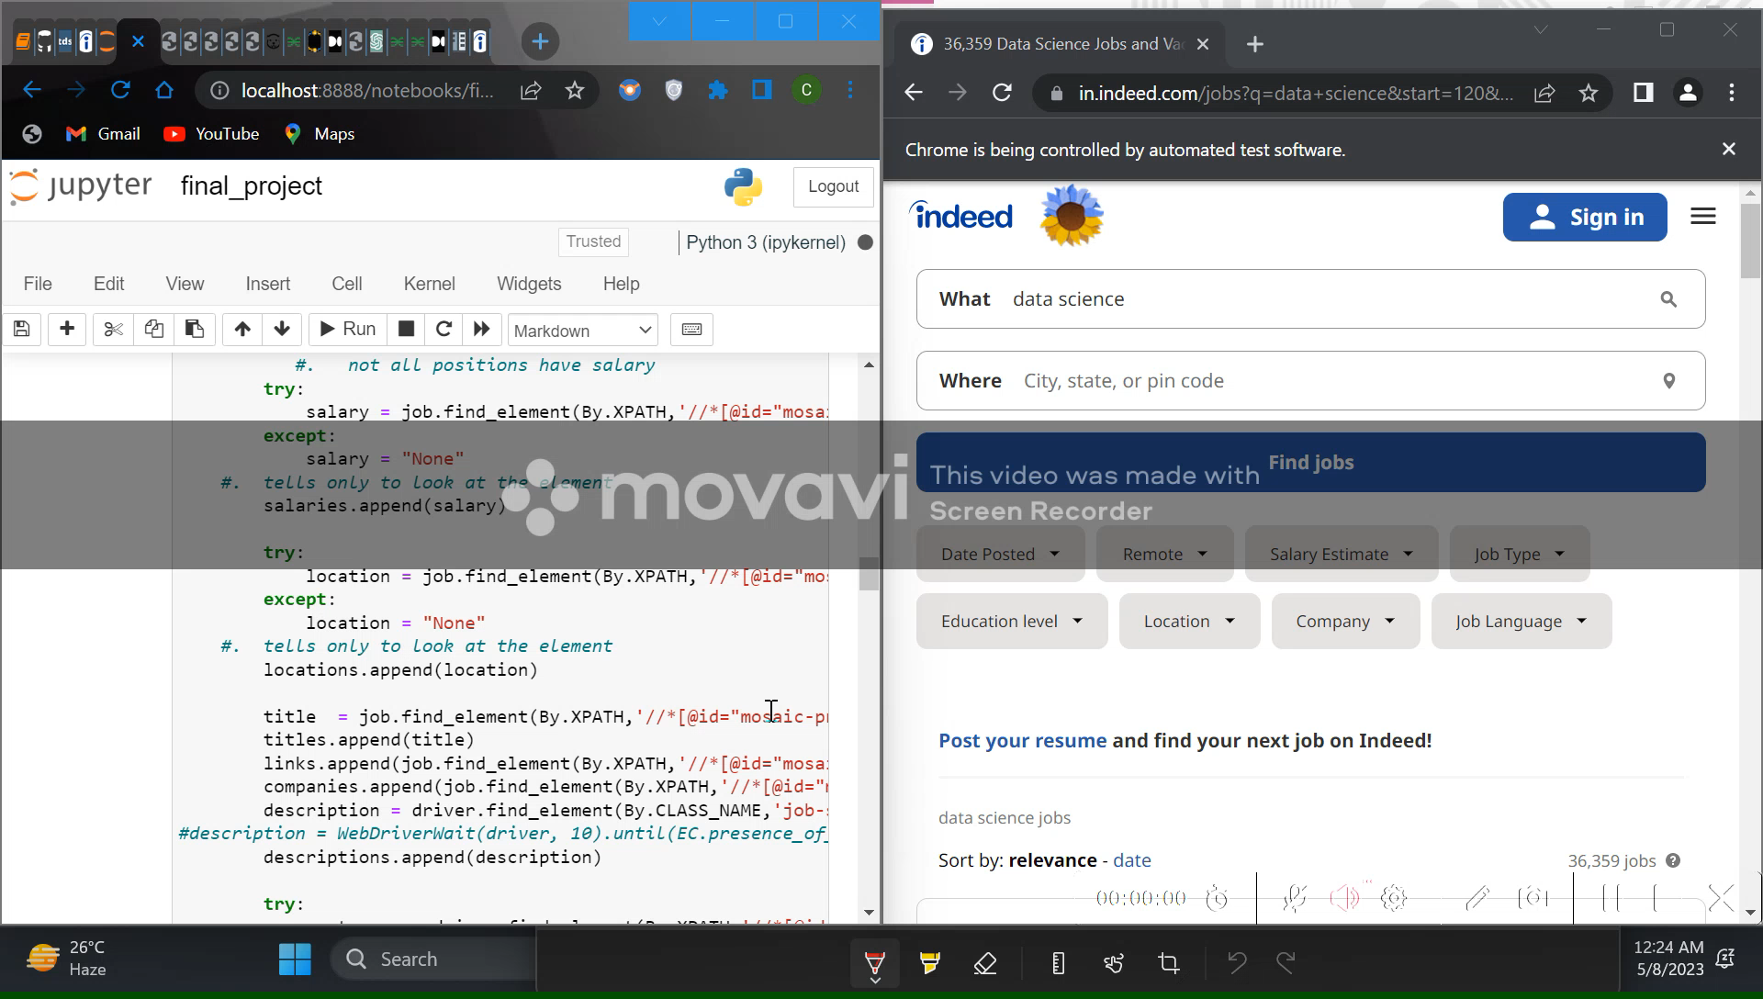
Working

Slide 10
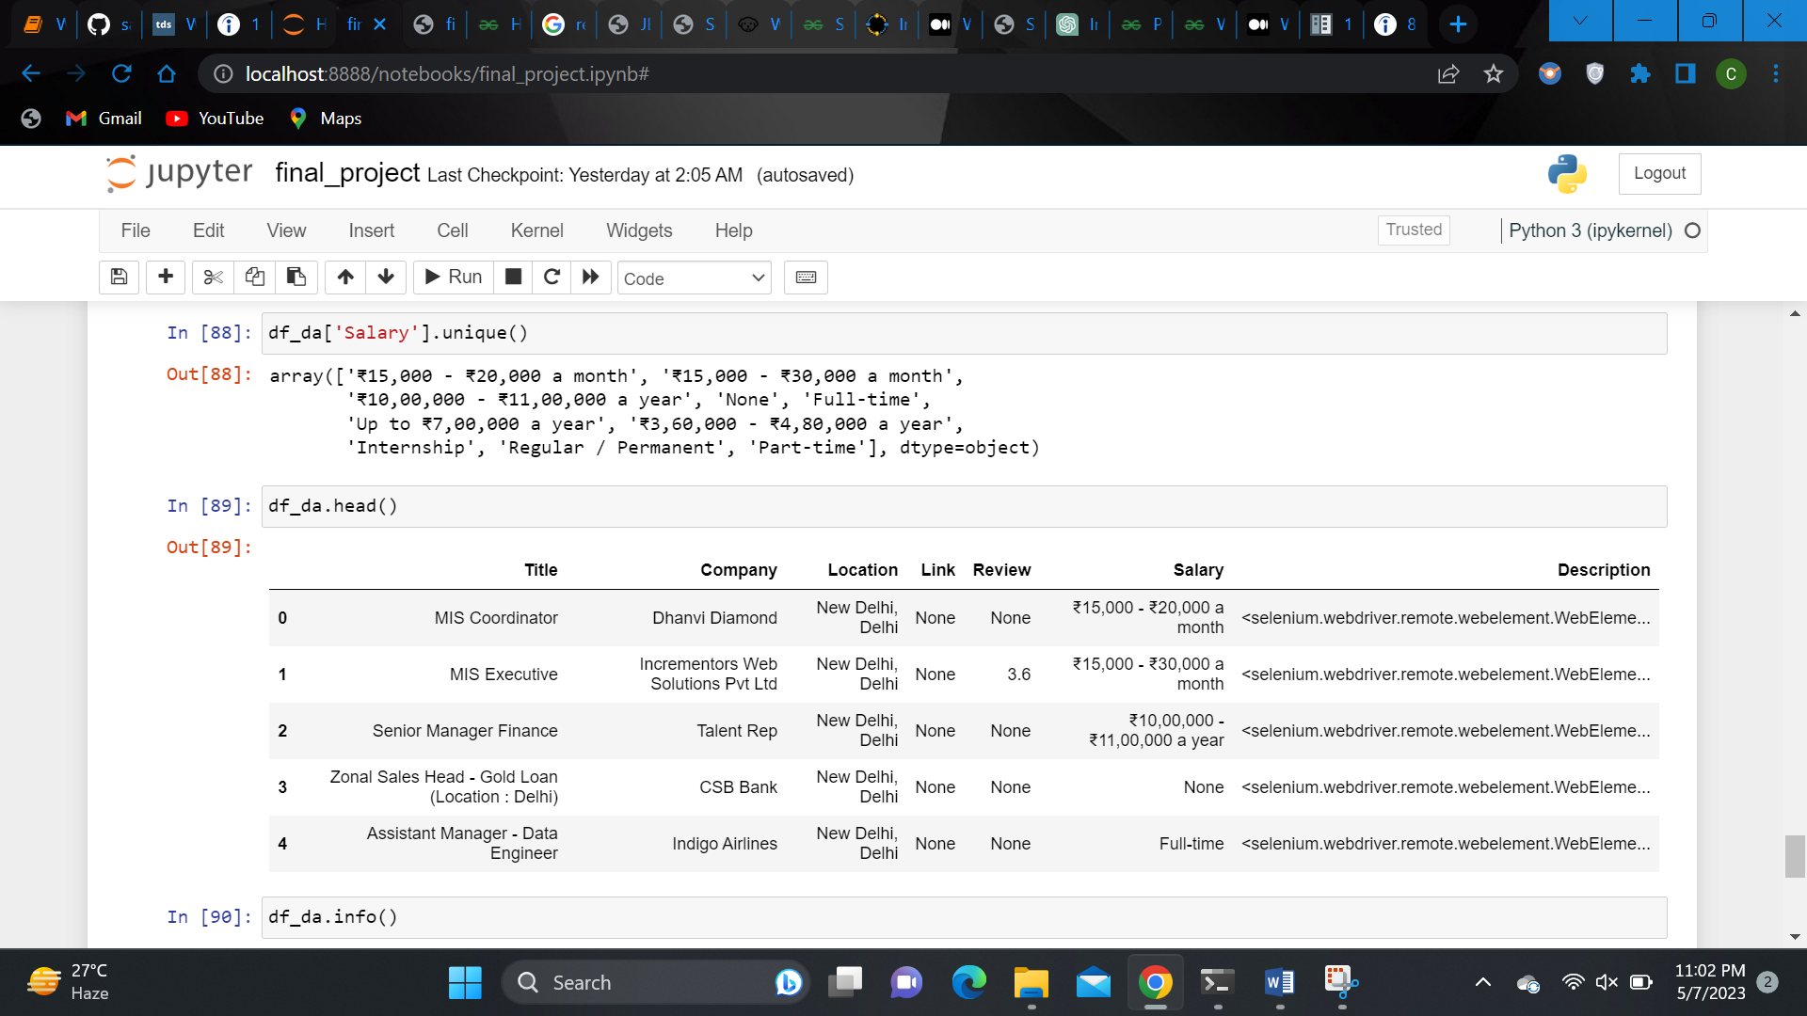
Results (dataframe)

Slide 11
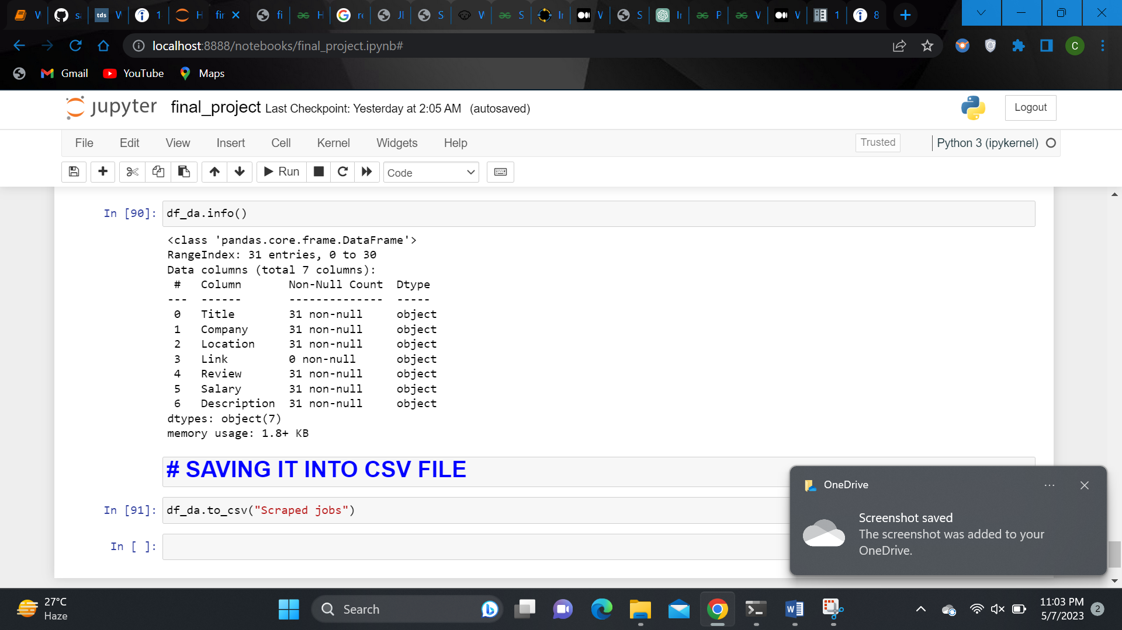
Results contd… (description of dataframe)

Slide 12
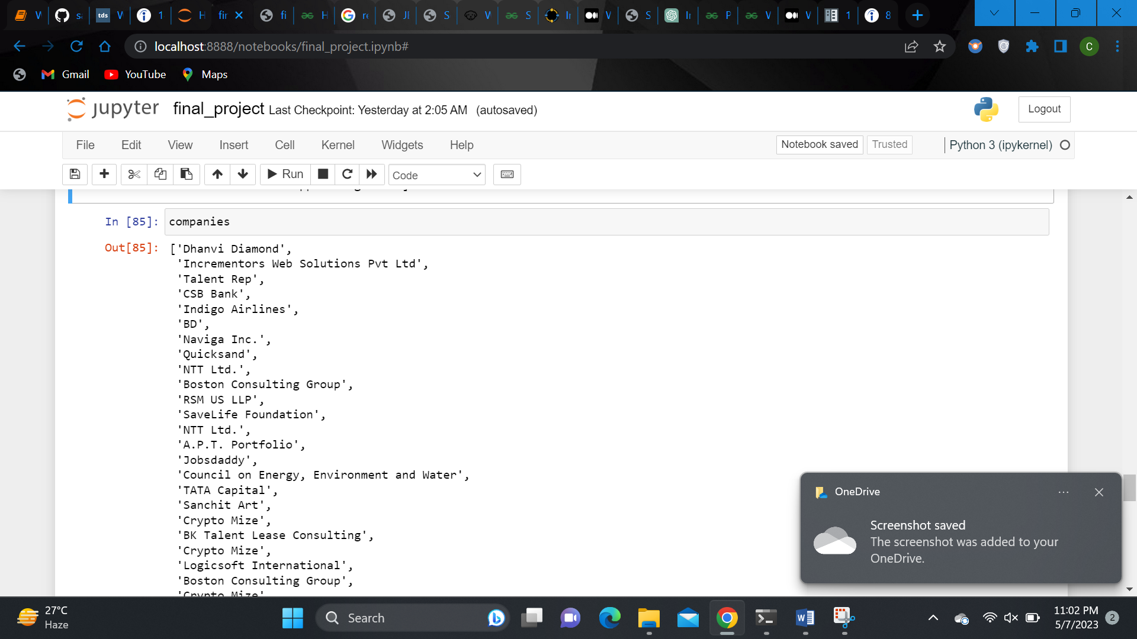
Results contd… (example of what we scraped)

Slide 13
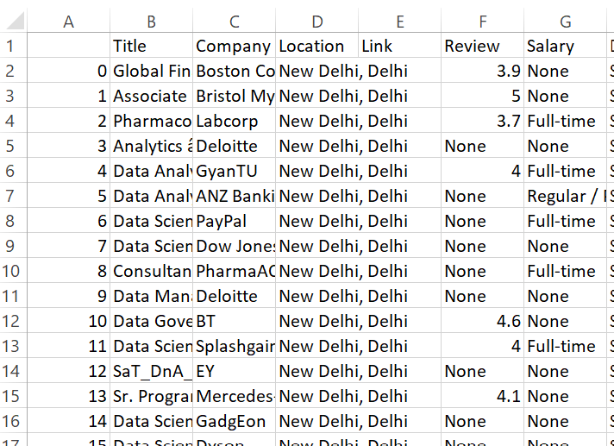
Results contd… (csv file)

Slide 14
CONCLUSION
We successfully extracted job postings data from the Indeed website using web scraping techniques.
We were able to extract data for multiple pages of job postings and saved the data in a CSV file format. The extracted data contained information such as job title, company name, location, job description, and other details.
it's important to ensure that web scraping activity complies with the website's terms of service and to be respectful of the website's bandwidth by implementing appropriate throttling and rate-limiting measures

Slide 15
LIMITATIONS
Web scraping can be a challenging task as websites often have anti-scraping mechanisms in place to prevent scraping.
These mechanisms can block the scraper's IP address or display CAPTCHAs, which can make scraping difficult or even impossible.
In addition, the extracted data may contain errors or inaccuracies, depending on the quality of the website's HTML code and the scraper's programming logic.
The study is limited to selected job portals only.
The study considers present available jobs posted in websites only.

Slide 16
Thank you

